Slide 1


Computer Applications to Behavioral Sciences
Lecture 16. Web development HTML Basics
https://psychology-courses.appspot.com/
Dr. Jibo He
Wichita State University
hejibo@gmail.com

Slide 2
Overview
HTML Defined
Syntax
Structure
Content
Posting Online

Slide 3
What is HTML?
Stands for Hyper Text Markup Language
The glue that holds the content on a web page together
Every page on the web is created in HTML, or some variant of it

Slide 4
HTML Files
Merely text files that contain hyperlinks and markup
Hyperlinks: ?
Markup:
HTML instructions that dictate how the web page is displayed
Read by browsers
But each web browser interprets HTML in its own way
With basic HTML, variances aren’t significant
But pages with advanced elements like multimedia and scripting can get hairy

Slide 5
HTML Syntax
3 aspects to HTML markup:
1. Elements
- Identify different parts of an HTML page by using tags
2. Attributes
- Information about the instance of the element
3. Entities
-Symbols like copyright (©) and accented letters (è)

Slide 6
Elements
The building blocks of HTML
Use elements to describe every piece of text on web pages
Made up of tags and content between tags
e.g.
<p></p>
<img>
<body></body>

Slide 7
Tags
Mark the beginning and sometimes the end of an element (tag pair)
Elements that describe a page’s structure always use tag pairs
<p>Welcome to the Kin 260 page!</p>
<p> tells the browser, “The paragraph begins here”.
</p> tells the browser, “The paragraph ends here.”

Slide 8
Tags, con’t.
Elements that insert something into a page use single tags
Don’t enclose content
<img src=“football.jpg” width=“75” height=“100”>
The <img> element references an image
When the browser displays the page, it replaces <img> with the file “football.jpg”

Slide 9
Attributes
Allow variety in how an element is displayed or functions
Syntax is:
<tag attribute=“value” attribute=“value>
Example
<img src=“football.jpg” width=“100” height=“100”>
<img is a flag to the browser to insert an image, while the attributes tell the browser how to display the image

Slide 10
Entities
Special characters that can be displayed on web pages
Begin with an ampersand (&) and end with a semicolon (;)
e.g. To display è in the browser, need to use &acute;
<p>Montr&acute;al</p>
List of HTML entities:
http://www.w3schools.com/tags/ref_entities.asp

Slide 11
Comments
Good programming practice to use comments in code to explain code functionality
Comments are not displayed in the final web page
Begin comment with the string <!--
End comment with the string -->

Slide 12
Structure of HTML Document
HTML version declaration
<!DOCTYPE HTML PUBLIC "-//W3C//DTD HTML 4.01 Transitional//EN" "http://www.w3.org/TR/html4/loose.dtd">
Contains info about the page’s HTML version
Header section
<head></head>
Contains info about web page
Body section
<body></body>
Contains content of web page

Slide 13
Example of HTML Structure
<!DOCTYPE HTML PUBLIC "-//W3C//DTD HTML 4.01//EN" "http://www.w3.org/TR/html4/strict.dtd">
<HTML>
<HEAD>
<TITLE>My first HTML document</TITLE>
</HEAD>
<BODY>
<P>Hello world! </P>
</BODY>
</HTML>

Slide 14
HTML Version Declaration
At the top of every html document, must have this declaration:
<!DOCTYPE HTML PUBLIC "-//W3C//DTD HTML 4.01 Transitional//EN" "http://www.w3.org/TR/html4/loose.dtd">
The declaration creates a valid HTML page
The declaration also tells the browser what version of HTML to support

Slide 15
The Head Element
Header that provides basic information about the document
Always enclosed inside <html></html>
Contains title and metadata
Data that describes the page
List of keywords
<head>
<title>Kin 260 Home Page</title>
<meta name=“keywords” content=“kinesiology, undergraduate, computers, Excel, HTML”>
</head>

Slide 16
The Body Element
Holds the content of the web page
Always enclosed inside <html></html>
Always comes after the <head> element
<html>
<head>
<title>Kin 260 Home Page</title>
</head>
<body>
<h1>Welcome to Kin 260!</h1>
</body>
</html>

Slide 17
Ex 1 – 1st HTML page
Download and save the HTML starter code
Make the following changes:
<head>
<title>HTML</title>
</head>
<body>
<h1>Hello World</h1>
</body>
</html>
View the results in the browser

Slide 18
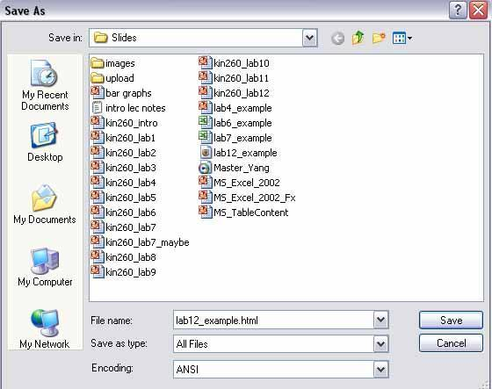
Saving your HTML file
File > Save As
Save as Type: All Files
Encoding: ANSI
File name: Example.html

Slide 19
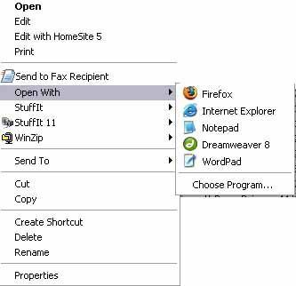
Viewing your HTML page
Find the file on your hard disk
Open the file using your web browser
If make a change to the html file, save in text editor, then refresh the page in the browser

Slide 20
Adding content to HTML pages
Inside the <body>, use text blocks to further create structure
Includes:
Paragraphs
Headings
Lists
Tables

Slide 21
Summary of Text Blocks
Tag
Description
Example
<p></p>
Paragraph
Most common block element used on pages
<p>Kin 260 is a class for undergraduate Kin majors.</p>
<h1></h1>
<h2></h2>
…
<h6></h6>
Headings and subheadings
h6 is the smallest heading
<h1>Welcome to the Kin 260 Home Page!</h1>
<br>
Line break
Like hitting the Enter key
<p>Today in Kin 260 …
<br>
HTML!</p>
<hr>
Solid straight line
<h1>Kin 260 Home</h1>
<hr>
<h2>Announcements</h2>

Slide 22
Ex 2 – Text Blocks
Create a web page that closely mirrors the following output:
Header One
Header Two
HTML isn’t so bad
after all.

Slide 23
Posting Your Pages Online
1. Need a web hosting provider to hold your web pages
Last time, we used Google Sites
Editor and Web Host
Web host might be the university web server, your Internet Service Provider or a specialized web hosting service
Usually, you pay your web host a monthly fee to act as your web server

Slide 24
Posting Your Pages Online (con’t.)
2. Use special software, called an FTP client, to upload files to the web server
FTP client will make connection to web server, and you copy files from your hard drive to the server

Slide 25
+/- of using a Web Host
+ Use any domain you want
Check www.godaddy.com to see if domain is available
+ Absolute control over folder paths, page content, layout
Not free
Must be proficient in HTML at the very least

Slide 26
Thank You

